Slide 1
MATH-352 Numerical Methods
Atifa Kanwal
atifa.kanwal@seecs.edu.pk
Office # 303, Faculty Block, SEECS, NUST

Slide 2
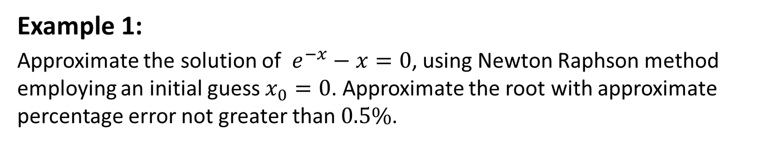
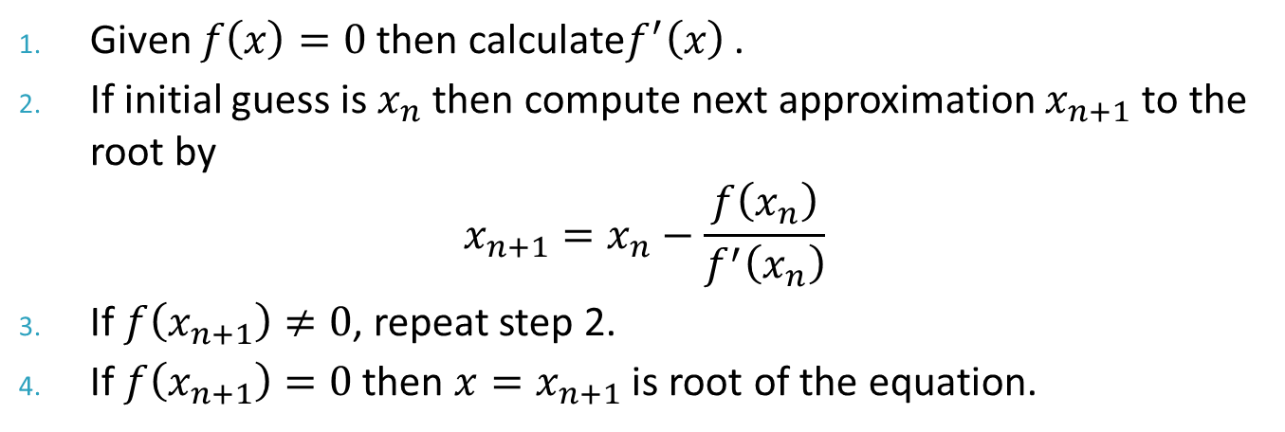
Newton Raphson Method: Algorithm
Given $f\left(x\right)=0$ then calculate$f^{′}\left(x\right)$ .
If initial guess is $x_{n}$ then compute next approximation $x_{n+1}$ to the root by
$$x_{n+1}=x_{n}−\frac{f\left(x_{n}\right)}{f^{′}\left(x_{n}\right)}$$
If $f\left(x_{n+1}\right)≠0$, repeat step 2.
If $f\left(x_{n+1}\right)=0$ then $x=x_{n+1}$ is root of the equation.
Example 1:
Approximate the solution of $e^{−x}−x=0$, using Newton Raphson method employing an initial guess $x_{0}=0$. Approximate the root with approximate percentage error not greater than $0.5\%$.

Slide 3
Advantages of Newton Raphson Method
It is one of the fastest methods that convergences quadratically to the root.
Near a root, the number of significant digits approximately doubles with each step.
This leads to the ability of Newton-Raphson Method to “polish” a root from another convergence technique.
Easy to convert to multiple dimensions.

Slide 4
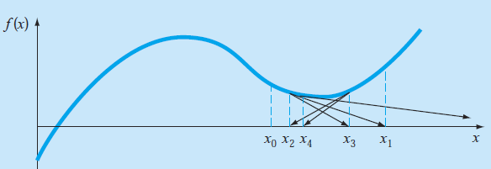
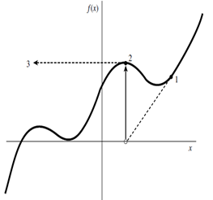
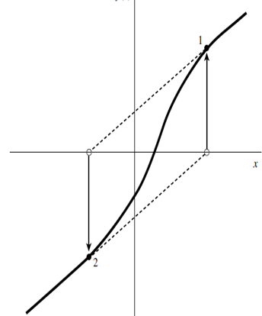
Disadvantages of Newton Raphson Method
1. Must find the derivative.
2. If initial guess is too far from local root then it may diverge.
3. It may encounter a zero derivative.
4. It may loop indefinitely

Slide 5

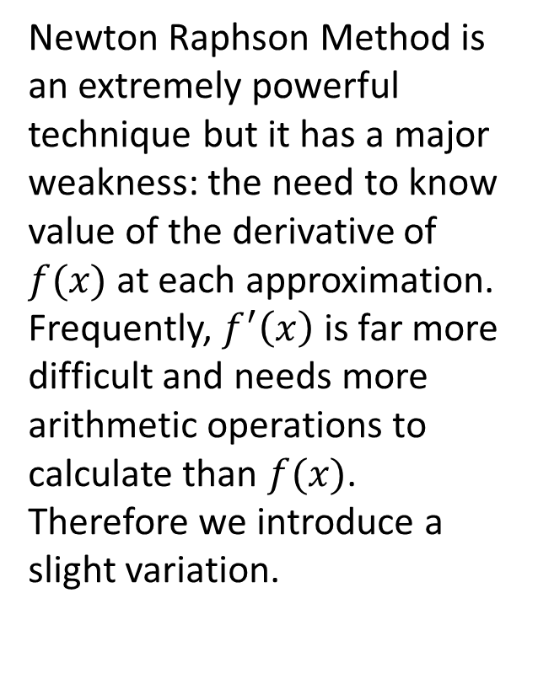







Secant Method
Graphically Interpretation
Newton Raphson Method is an extremely powerful technique but it has a major weakness: the need to know value of the derivative of $f(x)$ at each approximation. Frequently, $f^{′}\left(x\right)$ is far more difficult and needs more arithmetic operations to calculate than $f(x)$. Therefore we introduce a slight variation.
$$y=f(x)$$
$$\left(x_{0} , f\left(x_{0}\right)\right)$$
$$\left(x_{1} , f\left(x_{1}\right)\right)$$
$$x_{3}$$
$$x_{2}$$
$$x_{1}$$
$$x_{0}$$
$$root$$

Slide 6
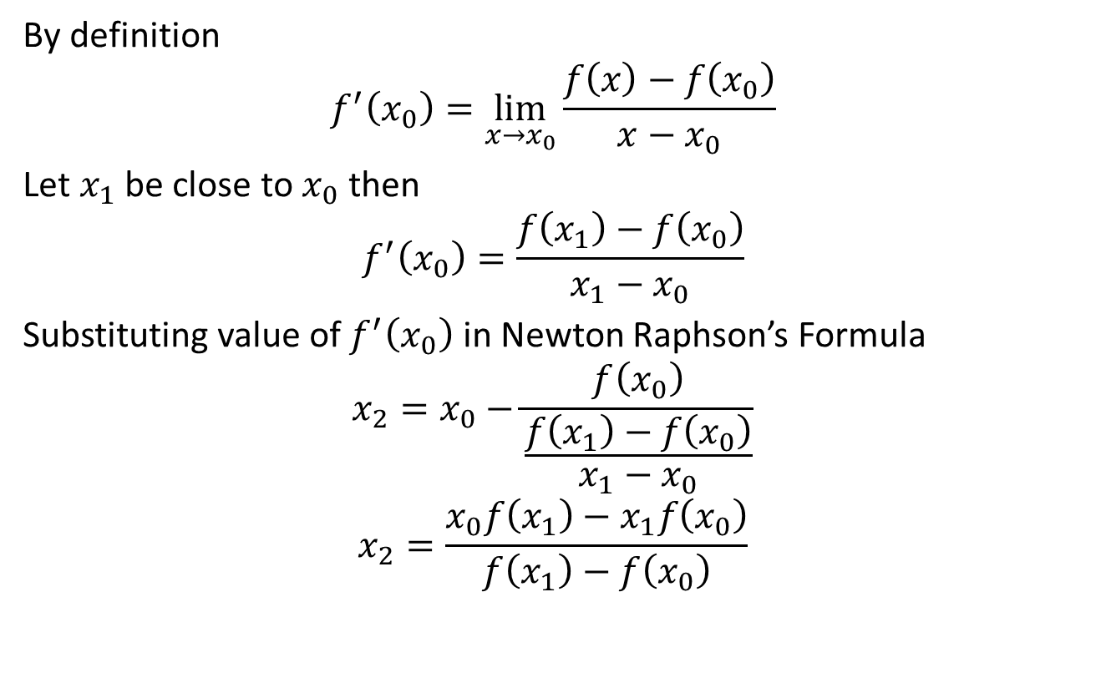
Derivation of Formula
By definition
$$f^{′}\left(x_{0}\right)=\lim_{x→x_{0}}{\frac{f\left(x\right)−f\left(x_{0}\right)}{x−x_{0}}}$$
Let $x_{1}$ be close to $x_{0}$ then
$$f^{′}\left(x_{0}\right)=\frac{f\left(x_{1}\right)−f\left(x_{0}\right)}{x_{1}−x_{0}}$$
Substituting value of $f^{′}\left(x_{0}\right)$ in Newton Raphson’s Formula
$$x_{2}=x_{0}−\frac{f\left(x_{0}\right)}{\frac{f\left(x_{1}\right)−f\left(x_{0}\right)}{x_{1}−x_{0}}}$$
$$x_{2}=\frac{x_{0}f\left(x_{1}\right)−x_{1}f\left(x_{0}\right)}{f\left(x_{1}\right)−f\left(x_{0}\right)}$$

Slide 7
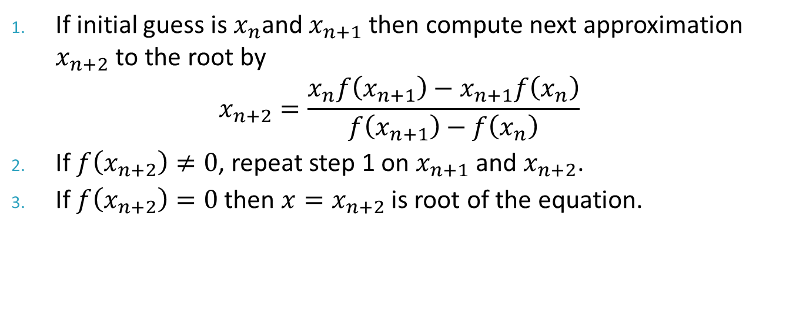

Generalizing
$$x_{n+2}=\frac{x_{n}f\left(x_{n+1}\right)−x_{n+1}f\left(x_{n}\right)}{f\left(x_{n+1}\right)−f\left(x_{n}\right)}$$
Algorithm
If initial guess is $x_{n}$and $x_{n+1}$ then compute next approximation $x_{n+2}$ to the root by
$$x_{n+2}=\frac{x_{n}f\left(x_{n+1}\right)−x_{n+1}f\left(x_{n}\right)}{f\left(x_{n+1}\right)−f\left(x_{n}\right)}$$
If $f\left(x_{n+2}\right)≠0$, repeat step 1 on $x_{n+1}$ and $x_{n+2}$.
If $f\left(x_{n+2}\right)=0$ then $x=x_{n+2}$ is root of the equation.

Slide 8
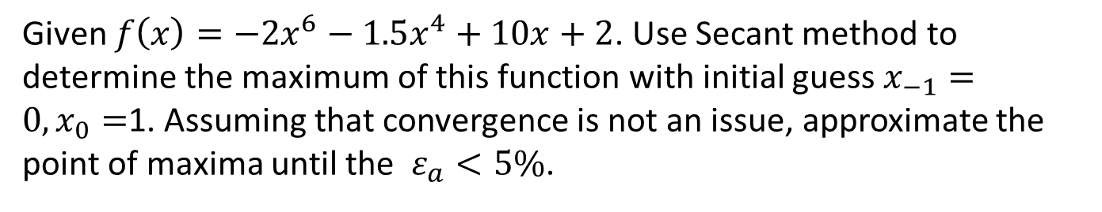
Example
Given $f\left(x\right)=−2x^{6}−1.5x^{4}+10x+2$. Use Secant method to determine the maximum of this function with initial guess $x_{−1}=0,x_{0}=$1. Assuming that convergence is not an issue, approximate the point of maxima until the $ε_{a}<5\%$.

Slide 9
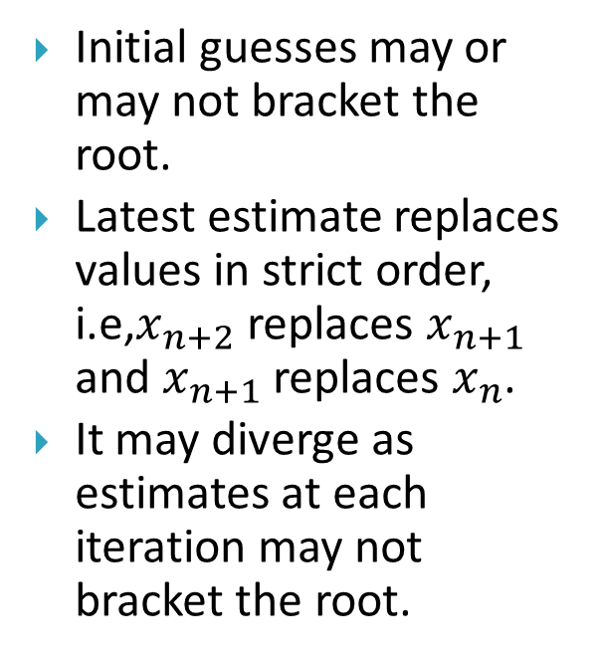
Difference between False Position and Secant Method
Secant Method
False Position Method
Initial guesses may or may not bracket the root.
Latest estimate replaces values in strict order, i.e,$x_{n+2}$ replaces $x_{n+1}$ and $x_{n+1}$ replaces $x_{n}$.
It may diverge as estimates at each iteration may not bracket the root.
Initial guesses must bracket the root.
Latest estimate of the root replaces whichever of the original values yielded a function value with the same sign.
It is always convergent as two estimates at each iteration bracket the root.

